Slide 1
Comp Sci 704
Principles of Programming Languages
Instructor: Ethan Cecchetti

Slide 2
What is a Program?
Tells a computer what to do
How do we know what it means?
Not always obvious

Slide 3
Odd Program Behavior
Wat: https://www.destroyallsoftware.com/talks/wat
[Gary Bernhardt 2012]

Slide 4
Odd Program Behavior
JavaScript
Python
“same object”
class Test {
amI(obj) {return this === obj}
}
var t = new Test(); t.amI(t)
var g = t.amI; g(t)
a = [1], 2
a[0] += [3]
In small groups:
Introduce yourself
  Program & year
  Interests
Analyze programs
What should they do?
What do they do?

Slide 5
Odd Program Behavior: Java
class A {
static final int a = B.b + 1;
}
class B {
static final int b = A.a + 1;
}
What should this do?

Slide 6
Odd Program Behavior
How do we know what a language does?
Test weird programs?
Need an implementation
Is there a bug?
What should we implement?
Need a specification!

Slide 7
Language Specification
How do we specify a programming language?
Industry: specification document
Formal Specification:
  Syntax
  Semantics
Often vague and ambiguous
What programs look like
What programs do

Slide 8
Formal Semantics
Precisely define these ideas!
Dynamic Semantics
Static Semantics
What happens when program runs
Reason about programs before they run
Operational Semantics
  Execution on abstract machine
Denotational Semantics
  Program as mathematical object
Axiomatic Semantics
  Logical formulae program obeys
Type Systems
  How sub-programs may interact
Static Analysis
  Many properties

Slide 9
Learning Outcomes
Inference rules, denotational semantics, etc.
You will be able to:
Define language features with formal models.
State and prove theorems about languages using a variety of techniques.
Analyze language properties with formal techniques.
Induction, logical relations, etc.
Termination, secure information flow, etc.
Type systems, abstract interpretation, etc.
Notes:
If you can already do all of these things with all of these techniques, this might not be the course for you.

Slide 10
What to Expect
Highly mathematical content
No programming
Comfort with set theory, induction, and functional programming all helpful
Written problem sets and exams

Slide 11
What to Expect: In Class
This is the only (planned) slide lecture
Board lectures
  Notes (hopefully) online after class
Activate participation!
Short break (about) halfway through
Questions help everyone learn!
Wide variety of backgrounds
Nobody can absorb technical math for 75 minutes straight

Slide 12
What to Expect: Homework
New ideas, not just “lecture practice”
Written problem sets
  Challenging material
  Work in groups, start early!
  Graded on an effort scale
    ✓ – engaged with material, did reasonably well
    ✓+ – did something surprisingly awesome
    0 – major gaps or significant misunderstanding
Goal is learning, not evaluation
unusual

Slide 13
What to Expect: Exams
Two take-home exams
  One midterm (late Oct)
  Cumulative final (Dec)
  Approximately 1 week
  Very picky grading
Course goal: learn to prove theorems very rigorously
General idea often simple

Slide 14
Grading
Assignment | Points
Problem Sets | 40%
Midterm | 25%
Final | 30%
Participation | 5%
Stop by Ethan’s office (MH 7649) by Sept 17! (During office hours, please)

Slide 15
More Information
Instructor: Ethan Cecchetti
Office: MH 7649
Office Hours: 2-3pm Tues, or by appointment
Contact: cecchetti@wisc.edu
Course Page:
cecchetti.sites.cs.wisc.edu/cs704/2025fa.html

Slide 16
Mathematical Preliminaries

Slide 17
Mathematical Basis
Set-theoretic approach
(Almost) everything is a set, question is which one!

Slide 18
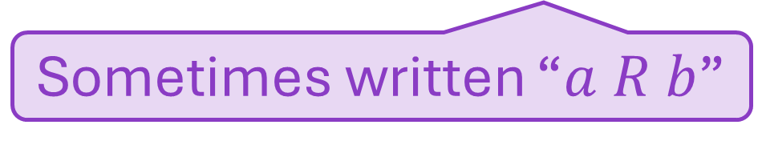

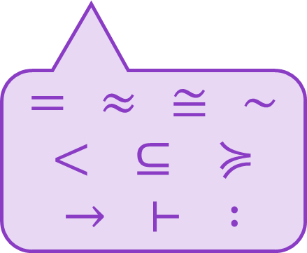
Binary Relations
Connects elements of domains $A$ and $B$
$R⊆A×B$
“$a$ is related to $b$” $\underset{⇔}{ △ }$ $\left(a,b\right)∈R$
Relation
Can be any sort of symbol
Defined to be
$=$ $≈$ $≅$ $∼$
$<$ $⊆$ $≽$
$→$ $⊢$ $:$
Sometimes written “$a R b$”

Slide 19

Binary Relations: Examples
Smallest Binary Relation:
Largest Binary Relation:
Identity Relation:
$∅$
$A×B$
$\{\left(a, a\right)∣a∈A\}⊆A×A$
Nothing
Everything
Domains are the same!

Slide 20



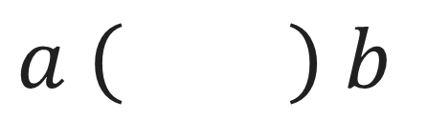
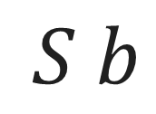
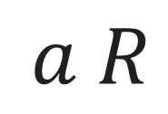

Relation Composition
First $R$, then $S$
$$a \left(R ;S\right) b$$
$R ;S$
$$c$$
$a R$
$$c$$
$S b$
Exists

Slide 21




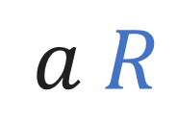
Relation Composition
First $R$, then $S$
$$a \left(R ;S\right) b$$
$R ;S$
$a R$
$$c$$
$$c$$
$S b$
=

Slide 22
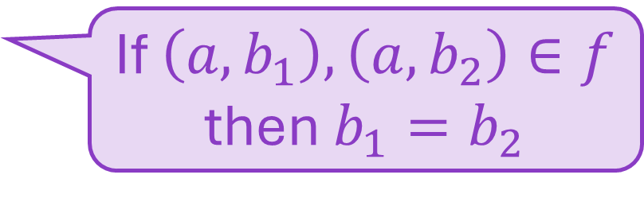
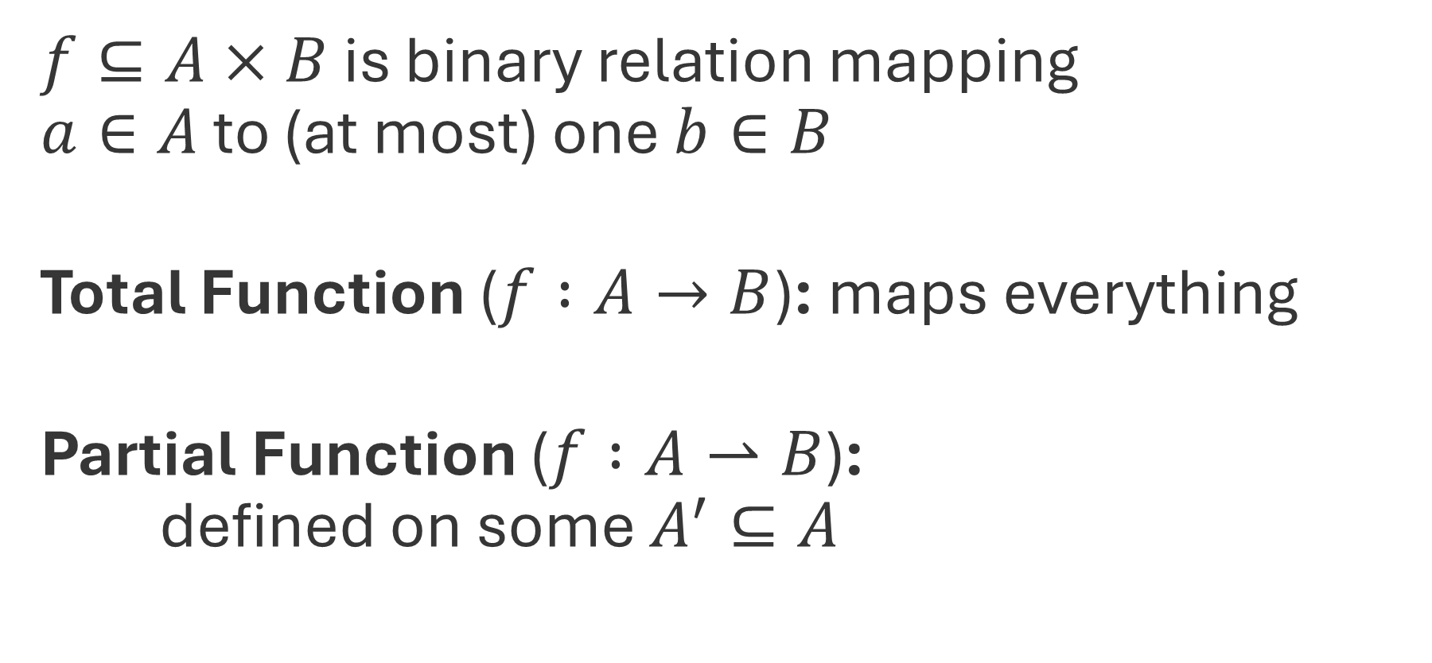

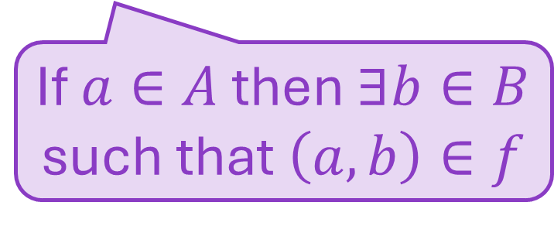
Functions
$f⊆A×B$ is binary relation mapping
$a∈A$ to (at most) one $b∈B$
Total Function ($f :A→B$): maps everything
Partial Function ($f :A⇀B$):
defined on some $A^{′}⊆A$
If $\left(a, b_{1}\right),\left(a, b_{2}\right)∈f$ then $b_{1}=b_{2}$
If $a∈A$ then $∃b∈B$ such that $\left(a, b\right)∈f$
$$dom\left(f\right)$$

Slide 23
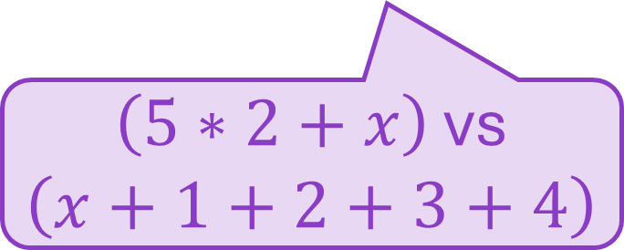
Function Representations
Extensional
Intensional
Function’s meaning
  Inputs and outputs
Describe computation
Multiple representations for same function
Mathematically, function equals its extension
$\left(5∗2+x\right)$ vs $\left(x+1+2+3+4\right)$
Define extensional meaning from intensional representation
Core of semantics

